Slide 1
Regex (in Python)
2025-2026

Slide 2
Regex - Regular expressions

Slide 3
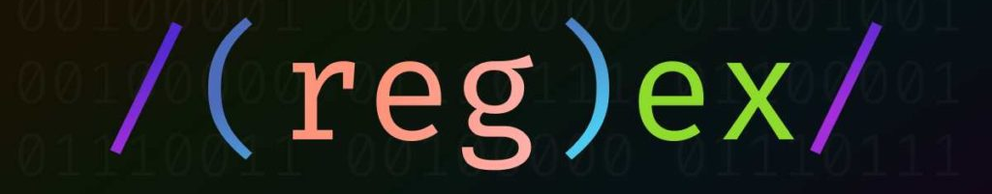
Regex
Regular expressions:
A regular expression (shortened as regex or regexp;^{[1]} also referred to as rational expression) is a sequence of characters that specifies a search pattern in text. Typically, such patterns are used by string-searching algorithms for "find" or "find and replace" operations on strings, or for input validation.
Notes:
https://coderpad.io/blog/development/the-complete-guide-to-regular-expressions-regex/

Slide 4
Regex – Stephen Cole Kleene (mid 1950)
Regular expressions → alternative notation for state machines
start
finish
a
c
0
1
2
Visual
Readable
2
Compact
Transferable
Easy to code
Regex = ac
Notes:
A finite state machine is an abstract machine that can be in exactly one of a finite number of states at any given time. The FSM can change from one state to another in response to some inputs; the change from one state to another is called a transition. Simple examples are: vending machines, which dispense products when the proper combination of coins is deposited; elevators, whose sequence of stops is determined by the floors requested by riders; traffic lights, which change sequence when cars are waiting; combination locks, which require the input of a sequence of numbers in the proper order.

Slide 5
Regex – alternative notation for state machines
a
c
Input Strings:
abc
ac
abbc
aacc
accu
0
1
2
2
Regex = ac

Slide 6
Regex – alternative notation for state machines
a
c
Input Strings:
abc
ac
abbc
aacc
accu
0
1
2
2
Regex = ac

Slide 7
Regex – alternative notation for state machines
a
c
0
1
2
Input Strings:
abc
ac
abbc
aacc
accu
2
b
Regex = ab*c
“*” means zero or more times

Slide 8
Regex – alternative notation for state machines
a
c
0
1
2
Input Strings:
abc
ac
abbc
aacc
accu
2
b
Regex = ab*c
“*” means zero or more times

Slide 9
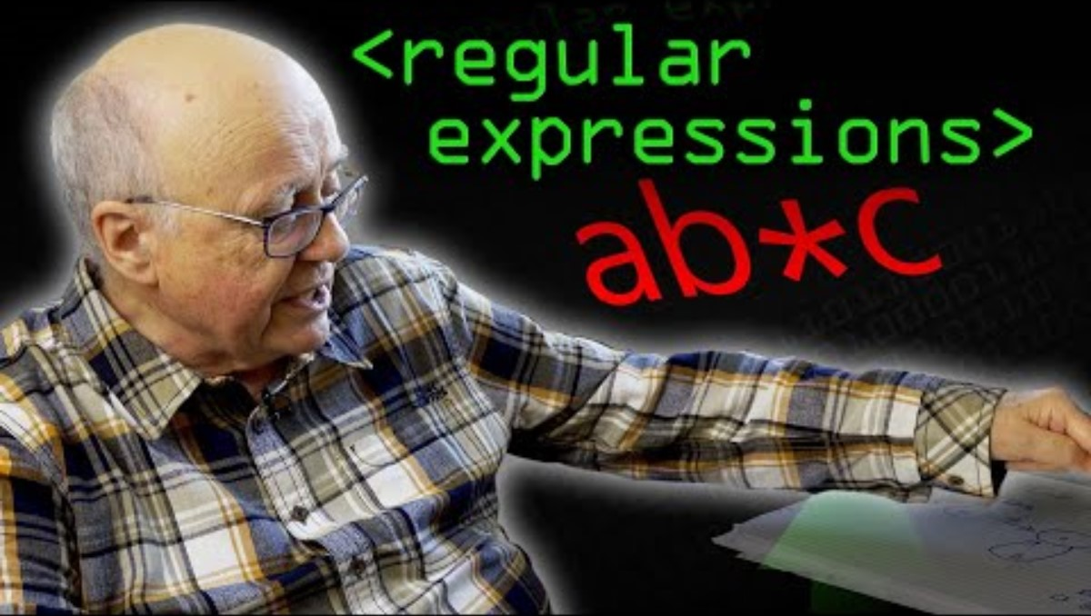
Regex – Must Watch!
Notes:
https://www.youtube.com/watch?v=528Jc3q86F8

Slide 10

Regex
Regexes can be used in any language, but we’ll be using Python
By themselves, they are rather theoretical, but in web scraping or data cleaning, you will see their usefulness.
Notes:
This line is spoken by Kesuke Miyagi, played by Pat Morita, in the film The Karate Kid, directed by John G. Avildsen (1984) Pat Morita was supposed to be teaching Mr. Macchio karate, but all summer the karate master had the kid just painting stuff and waxing his car. However, the painting and waxing techniques were secretly teaching his muscles karate moves, and when the karate lessons actually began, he found it relatively easy to learn. "Wax on, wax off" was one of the stern instructions repeated at the beginning of the lessons.

Slide 11
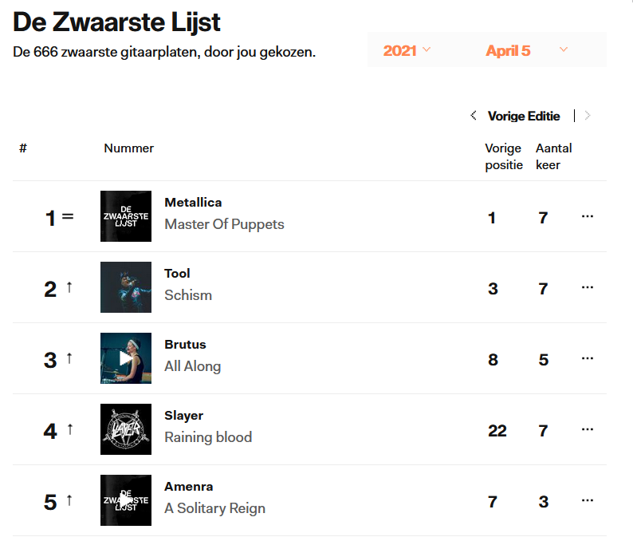
Regex
A regex is an expression which matches (or not matches) another string. This means you can check if a string is a properly formed date, or a gender, or …
You can also use regexes to extract parts of strings. Like taking al the bands from “De Zwaarste Lijst” on the stubru-website…
Note: they’re all bold
This means between “<b>”-tags in HTML
Notes:
https://stubru.be/stem/dezwaarstelijst/lijst

Slide 12
Basic regexes - How do we match stuff?
Not all strings are so straightforward to match as “abc” or “<b>”
What if we want to match:
any digit
a whitespace
a word that starts with any uppercase letter
a word at the start of the line
→ Tokens
Regex | Matches
\d | Any digit
\D | Any non-digit
\s | Any whitespace (space, but also newline)
\S | Everything but \s
\w | Matches any alphanumeric char (incl. “_”)
\W | Everything but \w
. | Any character, but only once
[a-z] | Any lowercase character
[A-Z] | Any uppercase character
[0-9] | Any digit, equal to \d
$ | End of string
^ | Start of string
Notes:
https://coderpad.io/blog/development/the-complete-guide-to-regular-expressions-regex/#pattern-collections

Slide 13
Basic regexes - How do we match stuff?
Not all strings are so straightforward to match as “abc” or “<b>”
What if we want to match:
Any vowel
A character that is either an “a”, “b” or “c”
A number between 1-5
→ Collections
Regex | Matches
[abc] | “a”, “b” or “c”
[^abc] | Everything but “a”, “b” or “c”
[a-z] | Any lowercase character
[A-Z] | Any uppercase character
[0-9] | Any digit, equal to \d
abc|def | “abc” or “def”
Notes:
https://coderpad.io/blog/development/the-complete-guide-to-regular-expressions-regex/#pattern-collections

Slide 14
Basic regexes - How do we match stuff?
Not all strings are so straightforward to match as “abc” or “<b>”
What if we want to match:
“b” zero or more times
just one “@” in an email address
exactly three “w” in a url (www)
→ Quantifiers
Quantifier | Multiplies how?
* | Zero or more times
+ | One or more times
? | Zero or once
{3} | Exactly three times
{3,6} | Three to six times
{3,} | Three or more times
{,6} | Up to six times
Notes:
https://coderpad.io/blog/development/the-complete-guide-to-regular-expressions-regex/#pattern-collections

Slide 15
Basic regexes - All together now!
Regex | Matches
a | The character “a”
abc | The string “abc”
Regex | Matches
[abc] | “a”, “b” or “c”
[^abc] | Everything but “a”, “b” or “c”
abc|def | “abc” or “def”
\d | Any digit
\D | Any non-digit
\s | Any whitespace (space, but also newline)
\S | Everything but \s
\w | Matches any alphanumeric char (incl. “_”)
\W | Everything but \w
. | Any character, but only once
[a-z] | Any lowercase character
[A-Z] | Any uppercase character
[0-9] | Any digit, equal to \d
Quantifier | Multiplies how?
* | Zero or more times
+ | One or more times
? | Zero or once
{3} | Exactly three times
{3,6} | Three to six times
{3,} | Three or more times
{,6} | Up to six times
Notes:
This slide is way overloaded, but it contains all you really need to know.

Slide 16
Regex groups
What if you want to match more than one item at a time?
When searching an email address you want to get:
First name
Last name
Student
Domain
Country
→ Groups
stef.vanwolputte@thomasmore.be
jos.eemlen@student.thomasmore.be
Notes:
(.) = 1 character .* = zero or more characters
\1 = the same as the first group which was (.)

Slide 17
Regex groups
A regex group is anything between brackets ( “(“ and “)” )
You can refer to these groups using \1, \2, \3, …
\1 is the first group, \2 the second, etcetera…
When applying regexes to strings, the groups are returned individually
When you don’t specify groups, the entire found text is returned
Example: word that begins and ends with the same letter: (.).*\1
Email address example: ^([a-z]+).([a-z]+)@(student.)?([a-z]+).([a-z]{2,3})$
Notes:
Word that starts and ends with the same character:
(.) = 1 character .* = zero or more characters
\1 = the same as the first group which was (.)
Email address: (an.andries@student.thomasmore.be/ jochen.marien@thomasmore.be) ^ = start of string
+= at least 1 time
? = 0 or more
{2,3}= 2 or 3
$ = end of string

Slide 18
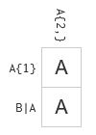
Regex
The previous slides are all you need to know
Now you can apply Regex in any language
PowerShell, Perl, Java, C#, …
Let’s try that first: https://regexcrossword.com/
Example:
A{2,} : At least two A’s -> AA
A{1} : Exactly one A -> A
B|A : B or A -> A
You should be able to finish the beginners, intermediate and expert puzzles
When in doubt, use https://regex101.com/ to explain why something is wrong

Slide 19
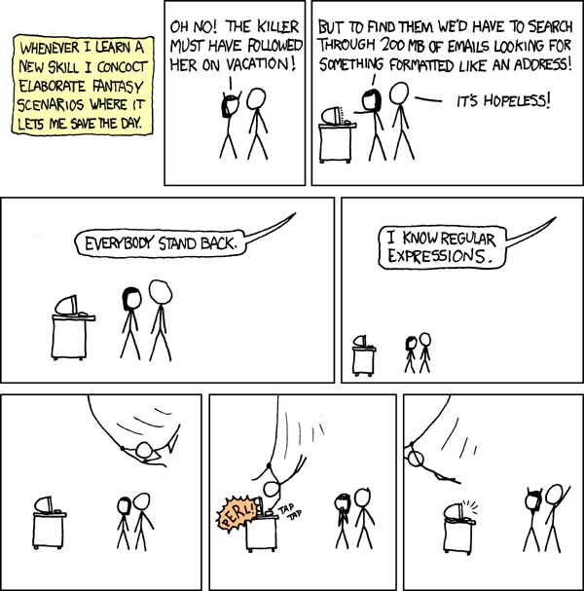
Notes:
https://xkcd.com/208/

Slide 20
Regex in Python

Slide 21
Regex in Python
All well and good, but how do we use this in Python?
First import “re” (usually not given an alias)
Then use one of the following functions:
re.search(regex, s): returns the first match of the regular expression, even if this match is in the middle of the string
re.match(regex, s): returns the first match of the regular expression, but only if this match is in the beginning of the string
re.finditer(regex, s): returns an iterator consisting of all matches of regex
re.findall(regex, s): returns a list of all matches of the regex
re.sub(regex, new_text, s): substitutes all matches of the regex in the input string s with new_text and returns this

Slide 22
Example:
import re s = "I went to the zoo and saw _lions_, _tigers_ and _meerkats_."
We start out with the text on top of this slide.
Note: “found” is not a string, but an object
https://docs.python.org/3.10/library/re.html#match-objects
When using this object remember you’re using groups in regexes
Hence the constant usage of ‘group’
When only looking for one match, group will always be zero (the first group, also the default option)
found = re.search(r"lion", s)
print(found)
Notes:
R-strings: Raw strings, used for regex because they don’t interpret the \ as a special character. Python raw string treats backslash (\) as a literal character. This is useful when we want to have a string that contains backslash and don't want it to be treated as an escape character (\t or \n)

Slide 23


Example: Match-object
found = re.search(r"lion", s)
print(found.group(), found.start(), found.end())
But did we visit the flamingos?
If nothing found, return value is of type “None” which evaluates to False in an if statement
found = re.search(r"flamingo", s)
print(found)
print("We found it!") if found else print("Nothing here...")
found = re.match(r"tiger", s)
print(found)
found = re.match(r"I\s", s)
print(found)
Notes:
Index position of lion is [27,28,29,30] -> found.end() 31 is not included!
Also: lookup “Python shorthand if”

Slide 24
Example: greedy *
Find the first animal (between underscores):
No correct result:
* is greedy: it will take as much as it can
2 solutions: match only characters, or match anything but underscore
found = re.search(r"_.*_", s)
print(found.group())
found = re.search(r"_[a-zA-Z]*_", s)
print(found.group())
found = re.search(r"_[^_]*_", s)
print(found.group())
Notes:
* = zero or more

Slide 25

Example: iterators and iterables
We want to know all animals
finditer: returns an iterator, not an iterable
findall: returns a list, which is an iterable
https://www.geeksforgeeks.org/python-difference-iterable-iterator/
Any iterable can be used to generate an iterator. This is what is done implicitly when used in a loop.
Iterables: string, list, tuple, …
You’re used to iterables, so use findall instead
found = re.finditer(r"_[a-zA-Z]*_", s)
for f in found:
print(f.group())

Slide 26


Example: find more
found = re.findall(r"_[a-zA-Z]*_", s)
[print(f) for f in found]
Since we’re using findall, we don’t get Match-objects anymore but a simple list of matches.
But the underscores are annoying. We need them to search for the animals, but we know they’re there and don’t need them in the result.
The solution: parenthesis. Put the part of the regex you’re interested in between them.
found = re.findall(r"_([a-zA-Z]*)_", s)
[print(f) for f in found]
Notes:
() refer to a group – so the first group is picked

Slide 27
Example: replace
Let’s get rid of all the underscores.
Or let’s replace every T that is followed by another letter with an X.
What happened? The entire regex was replaced, not just the T. To fix that we have to use groups!
new_s = re.sub(r"_", r"", s)
print(new_s)
new_s = re.sub(r"t[a-zA-Z]+", r"X", s)
print(new_s)

Slide 28

Example: replace using groups
new_s = re.sub(r"t([a-zA-Z]+)", r"X\1", s)
print(new_s)
“\1” is the first group that was found
You can also use \2, \3, …
A group is anything between brackets
Can also be used in the expression itself, like checking if the first character is the same as the last:
found = re.match(r"(.{1}).*\1$", "hannah")
print(found)
found = re.match(r"(.{1}).*\1$", "kasper")
print(found)
Notes:
Trick question:
found = re.search(r"(.{1}).*\1$", "marieke")
print(found)
True or false? And why is that not a problem with the examples in the slide?
True (match op ‘eke’)
# solution to make sure search starts with the first char
found = re.search(r"^(.{1}).*\1$", "marieke")
print(found)

Slide 29
Time to practice
Exercises
R-numbers
Numbers in text
Find text
…
Exercises from the advent of code 2015:
Day 5
Day 6

